Slide 1





Slide 2

Predicting Hotel Booking Cancellation in Portugal Project. Is a machine learning classiﬁcation project that will try to predict whether a booking will be cancelled or a booking will not be cancelled using machine learning based on historical data.
The data for this project is from Hotel Booking Demand Dataset Sciencedirect. This data was acquired by extraction from hotel’s Property management system from 2015 to 2017 from hotel in Region Algarve and Lisbon

Slide 3



Hotel industry is one of the faster growing businesses of tourism sector, especially with the rise of giant OTA that make booking a hotel as easy as is ever been.
According to Portugal’s National Institute of Statistic in 2017 hotel revenue rose approximately 18% to
$3.6 billion

Slide 4



Hotel revenues in 2017
Nominated as the most attractive European Cities (Lisbon) for hotel investment in 2020
source : Deloitte Hospitality Atlas 2019
20.6 million of Total Guest in 2017
(Portugal Population in 2017 : 10.31 million)
source : skift

Slide 5
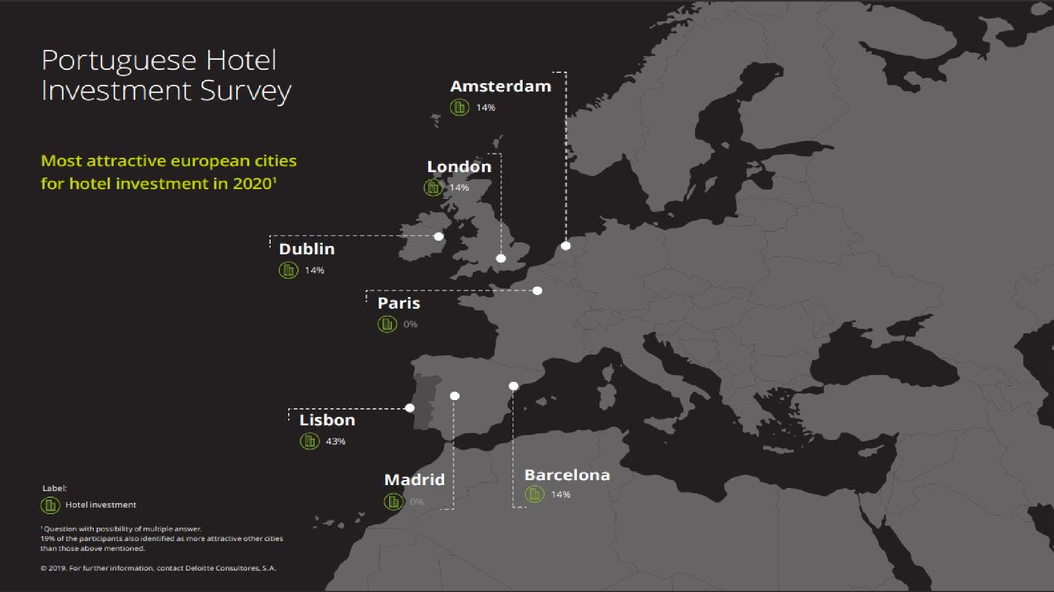

Slide 6




the growing trend of Hotel industry is beneﬁcial for hotels however it comes with it’s problem too.
One of the problem is the rising rate of cancellation in the hotel industry
Cancellation rate rose from under 33% in 2014 to 40% in
2018
source : Phocuswire

Slide 7


With the increase trend of cancellation from year to year, some hotel have think that high cancellation in hotel is the new norm of the industry which is a completely wrong approach.
One out of four hotel guests are cancelling hotel booking ahead of a stay. This cancellation trend has effect the hotel not being able to accurately forecast occupancy within their revenue management.
This trend of cancellation also have causes hotel loss in opportunity cost (unsold room due to cancellation)

Slide 8

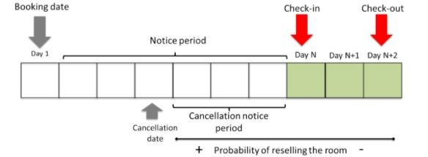
1. Loss of income in shape of unsold room (due to cancellation)
2. Lower RevPAR (Revenue Per Available Room) when selling cheaper at the last minute
Cancellation that’s close to checkin leave a very little spot for hotel to maneuver and resell the room. on many occasion no alternative way but to lower the room price

Slide 9


The Goals of this project is to ﬁnd out the characteristic of customers who cancelled and ﬁnding a pattern in cancelled booking by doing an exploratory data analysis
Building classiﬁcation machine learning model to predict cancellation, Above 0.75
Build and Deploy web application / dashboard using ﬂask from our machine learning algorithm, that can predict of cancellation based on user input

Slide 10


List of Question to help achieving the goal
How Market Segment Of Booking Affecting Cancellation
How’s a lead time of a booking affecting cancellation
How’s different deposit type affecting cancellation of a booking
How does cancellation rate of booking from portugal and booking that’s made outside portugal
What Are The Other Factors that affecting cancellation of booking
What machine learning algorithm that has the highest accuracy when it comes predicting hotel booking cancellations

Slide 11

Project Limitation
This hotel booking cancellation project only applied for hotel bookings in Lisbon Region and Algarve Region both location are located in portugal.
predicting cancellation with this web application outside both region might have not so accurate result due to the location constraint, different pattern of cancellation

Slide 12


Slide 13





Machine Learning process on predicting hotel cancellation from model building to hyperparameter tuning
Analysis on characteristic of cancelled booking & non cancelled booking
My Recommendation / Input on how to reduce cancellation based on the exploratory data analysis
insight

Slide 14
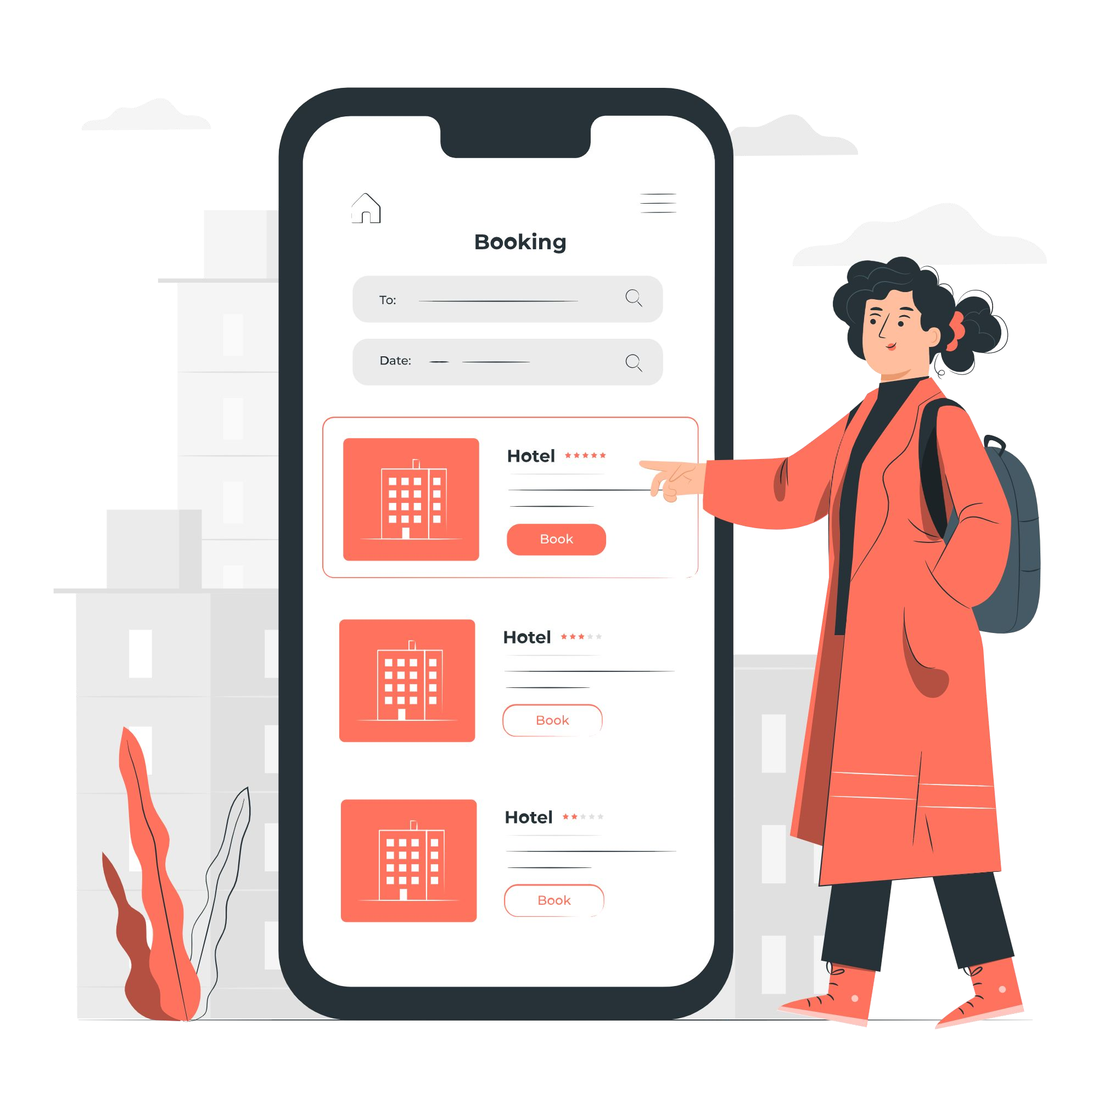

Slide 15
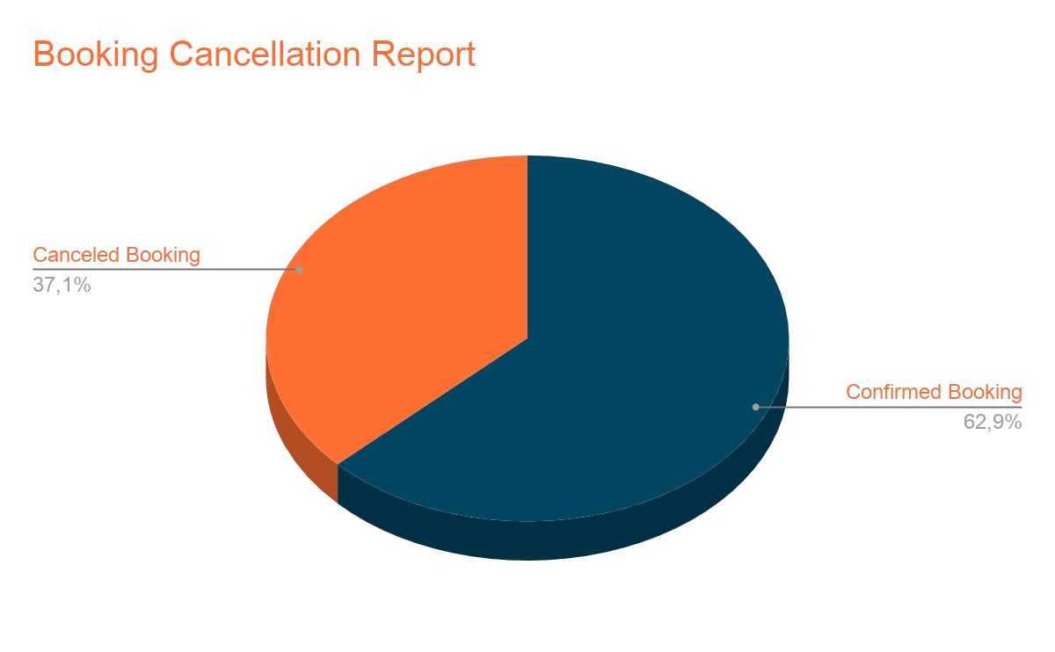
Based on the dataset we see that percentage of cancellation in portugal from July 2015 - August 2017 is 37.1%, which is slightly below industry standard around that year at 41. 3%
source : Hotel management net

Slide 16
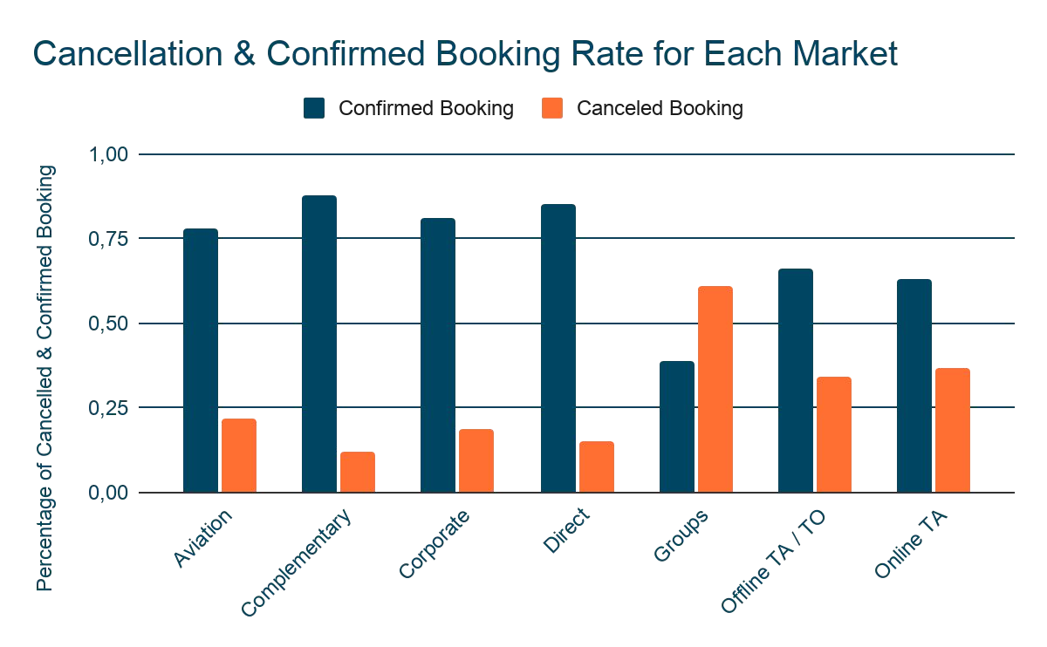
from our analysis we see that corporate , Direct , and Aviation has a cancellation rate around 18
- 22 % of their booking
Travel Agent (Online / Ofﬂine)
has a cancellation rate around 34
- 36 %
Lastly Group has the highest cancellation rate around 61 %

Slide 17
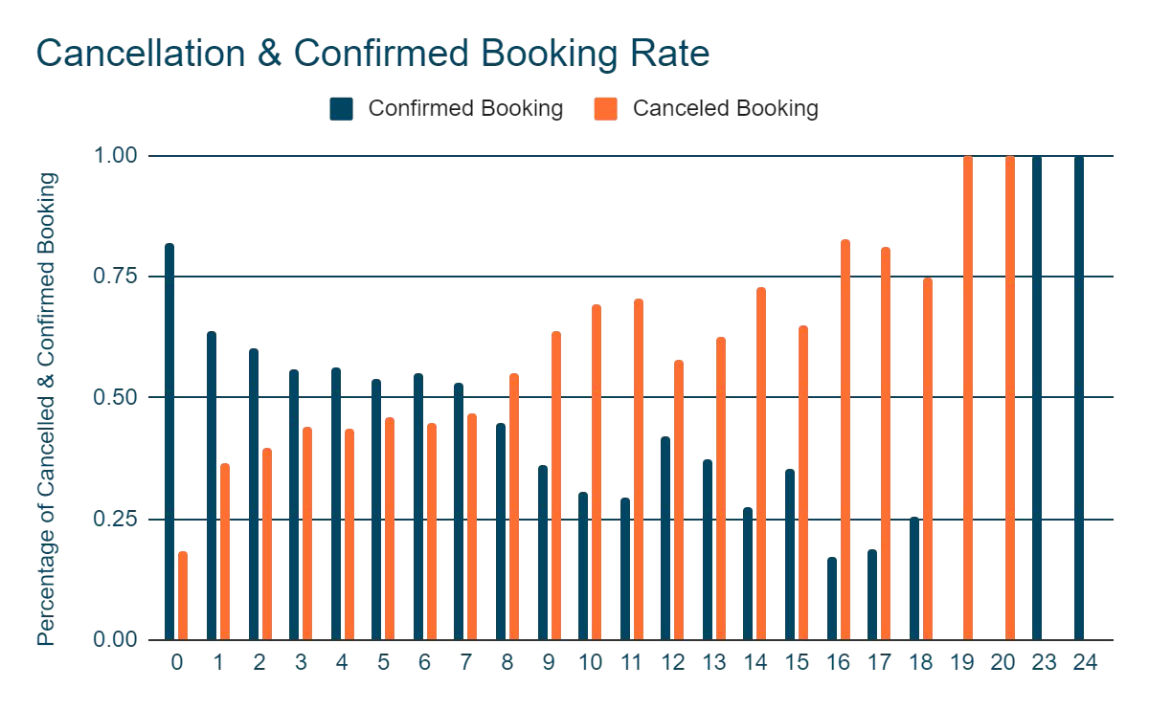
Booking that has less than or equal to 7 months lead time have a higher conﬁrmed booking rate (>50%) to it canceled rate
Booking that has more than 7 months have a higher cancellation rate compared to it’s booking rate
cancellation is positively correlated with lead time
the higher the lead
time the higher the cancellation rate
the shorter the lead time the less likely the booking will be cancelled

Slide 18
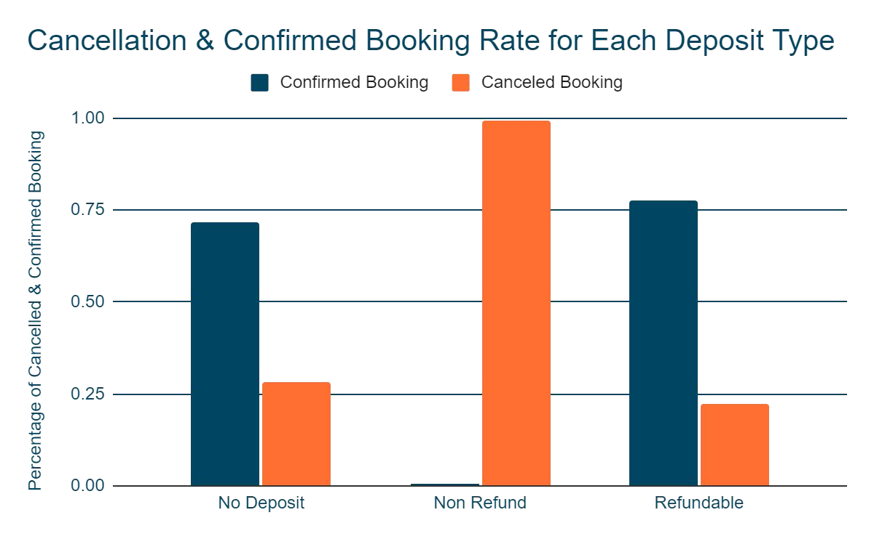
Non Refund Deposit type has the highest cancellation rate among all deposit type (99.4 %)
No Deposit has the second highest cancellation rate at (28.3%)
Refundable Deposit has the lowest cancellation rate among all of the deposit, it cancellation rate is at (22%)
For the hotels this is nothing alarming since they don't lose revenue when no refund booking is canceled. but it’s always a good practice to question something that’s extraordinary happening. In this case we will take a closer look at the median lead time for each deposit type

Slide 19

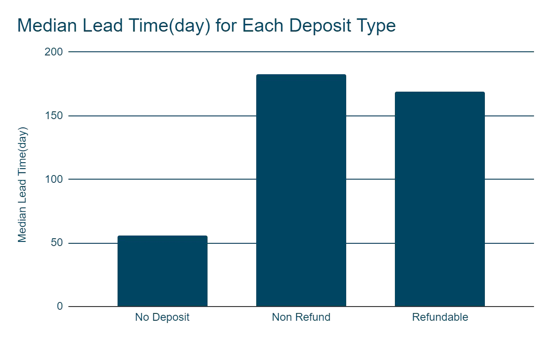
Based on the previous analysis we saw that non refund booking has the highest cancellation rate compared to other booking type,
and based on lead time and cancellation analysis we saw that the longer lead time has higher cancellation rate compared to the shorter one
Median Lead Time Non Refund 183 Days
Median Lead Time Refundable 169 Days
Median Lead Time for No deposit 56 Days

Slide 20

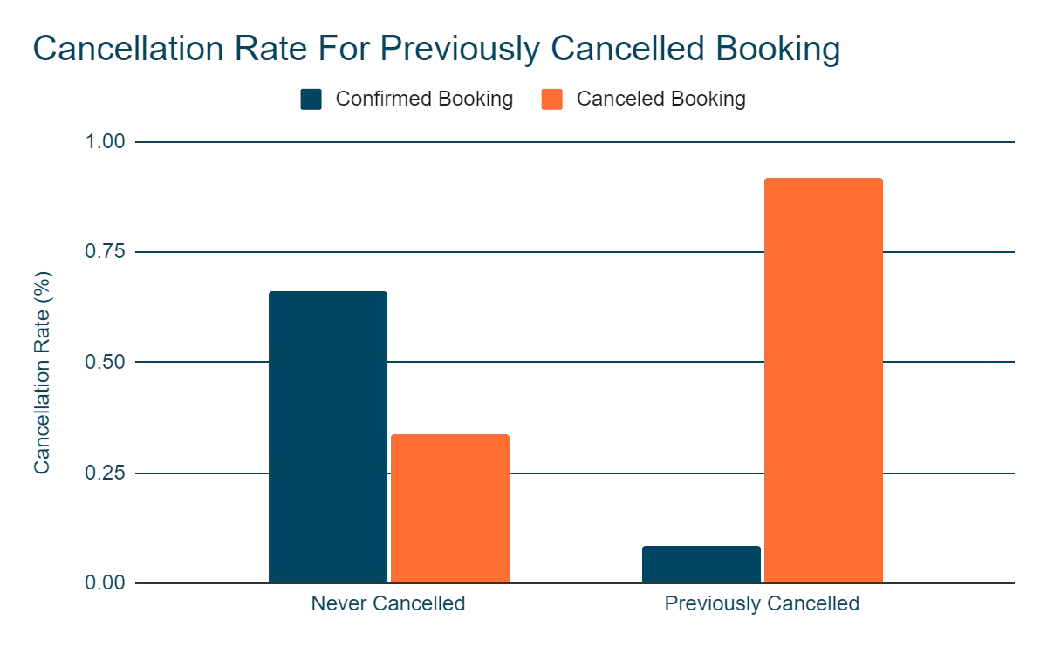
Booking That’s previously Canceled has 92% cancellation rate
Booking that’s never been canceled before has cancellation rate of 34%
this shows that booking that has been canceled before will more likely to be cancelled again

Slide 21


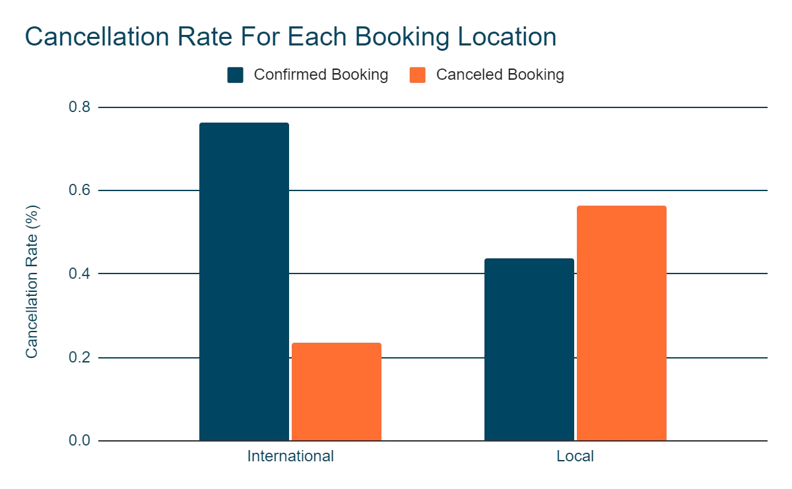

International Booking has 24% Cancellation Rate
Local Booking has 56% Cancellation Rate
This arise a question
Why does local booking are more likely to be canceled compared to international booking ?

Slide 22

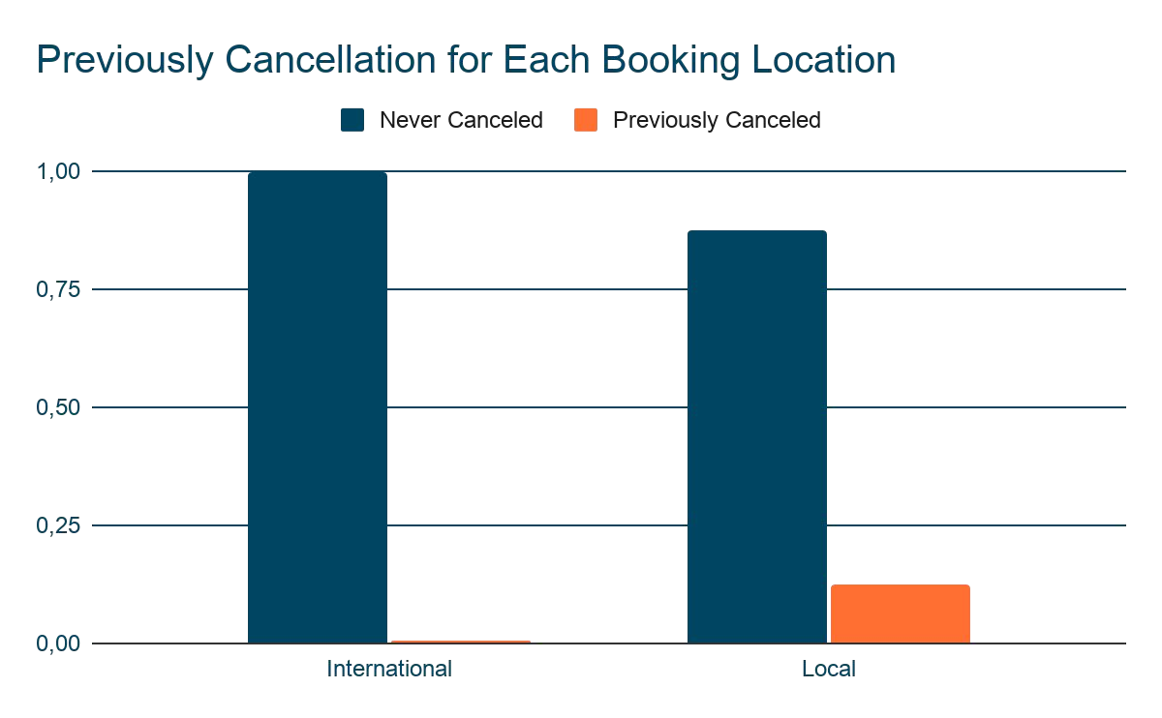
based on the previous analysis we saw that booking that has been canceled before has a cancellation rate of 92 %
For international booking 99.5% of international booking never been canceled before
while for local booking 13% of bookings has been canceled before
This higher number of previous cancellation deﬁnitely is one of the factors why local booking has a higher cancellation rate compared to international booking

Slide 23


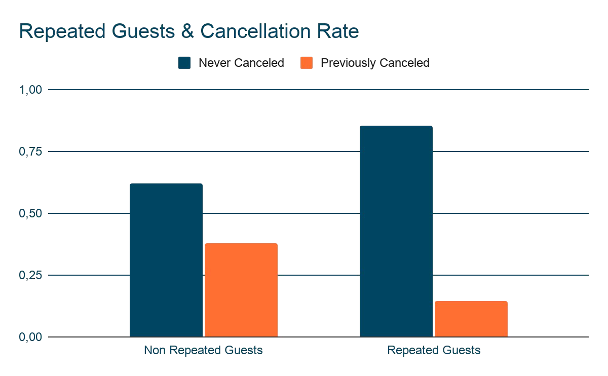
Repeated guests cancellation rate is around 14 %
Non Repeated guests are more than 2 x more likely to canceled their booking compared to repeated guest (34%)
in conclusion :
repeated guests are more likely to conﬁrmed the booking compared to non repeated guests

Slide 24
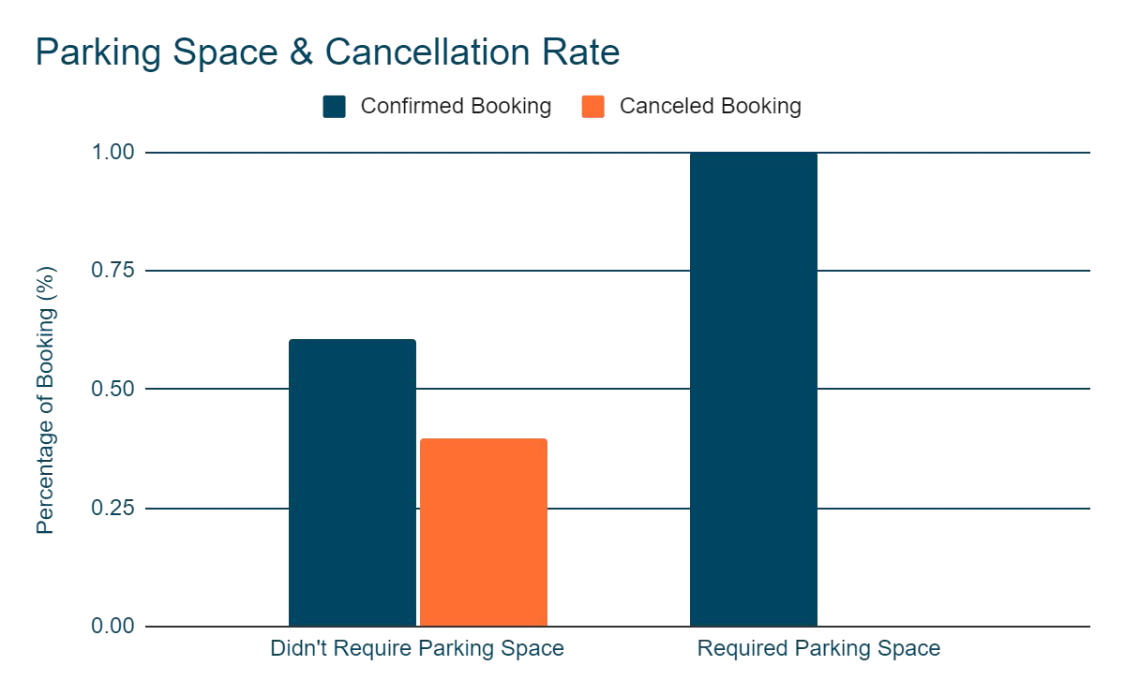
From July 2015 to August 2017 There are 7407 (6.2 %) out of total booking that required a parking space .
Out of 7407 bookings that required a parking space there’s not a single booking that’s canceled ( 0 Cancellation for booking that required a parking space)
This conclude booking that required a parking space will most likely be conﬁrmed

Slide 25



Slide 26
Only Non Refundable Deposit For Group Booking
Maximum Lead Time for Booking
Combination of Restriction
From the analysis we see that group booking has the highest cancellation rate.
With this policy hotel wouldn’t suffer any loss of revenue or loss of potential revenue due to cancelled group booking
We see a pattern of booking that has more than 210 days lead time are more likely to be canceled
setting up a maximum lead time means users wouldn’t be able to make booking that’s too far in advance
Setting up maximum lead time for booking might have resulted in hotel visibility to the potential guest search.
Combining deposit type lead time might help to get the hotel more exposure without higher risk of losing revenue. (ex. Non Refundable Deposit only for booking > 210 days in advance)

Slide 27
Increase Direct Booking Market Segment
Stricter Cancellation Policy For Previously Canceled Booking
Attracting Customers Who Drives
From this dataset we see that direct booking has the least cancellation rate at 15% (outside complimentary)
with only being 10 % of the total booking, the increase of direct booking might lead to less cancellation
strategy to increase direct booking
Booking that’s previously canceled has cancellation rate of 92%.
looking at this pattern we see that booking that’s previously canceled are most likely to be canceled again.
to protect hotel from losing revenue due to this kind of cancellation, hotels need to set booking payment in advance / non refundable deposit, for booking that has been canceled before
6% of total booking required a parking space (7407 bookings), and out of 7407 bookings none of them were canceled.
That’s around 10% of total conﬁrmed booking. Hotel could promote to attract customer that drives

Slide 28



Slide 29

Algorithm Used:
Logistic Regression
KNeighbors Classiﬁer
Decision Tree Classiﬁer
Random Forest Classiﬁer
XGB Classiﬁer

Slide 30
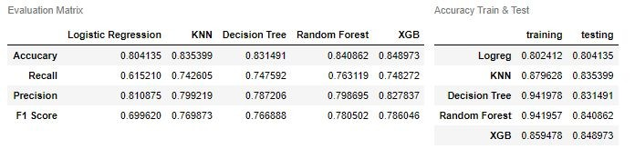
KNN, Decision Tree, Random Forest
algorithms have overﬁtting condition
Accuracy as The Primary Evaluation Matrix
XGB Classiﬁer has the best accuracy Score in the base model
First because the data is somehow balance between the target class (63%) Conﬁrmed, 37% Canceled
Every Class is equally important

Slide 31
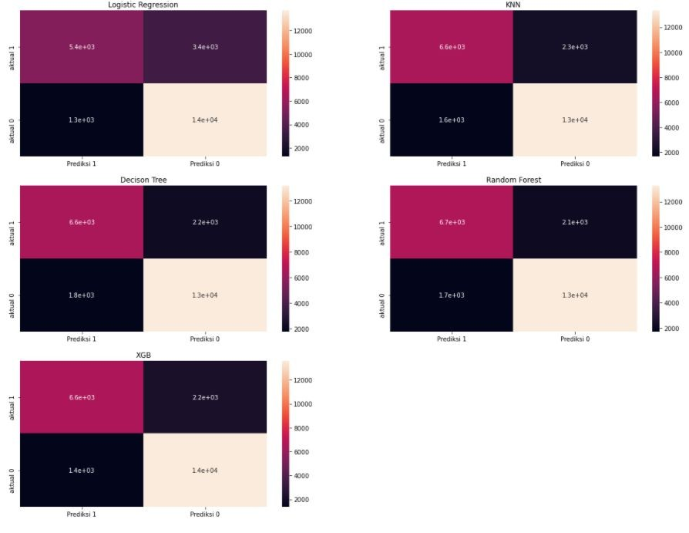

Slide 32
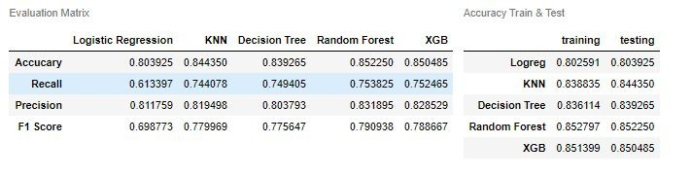
No More Overﬁtting Condition in All The Algorithms
After Hyperparameter Tuning Random Forest Classiﬁer Has The Highest Accuracy Among All Algorithms

Slide 33
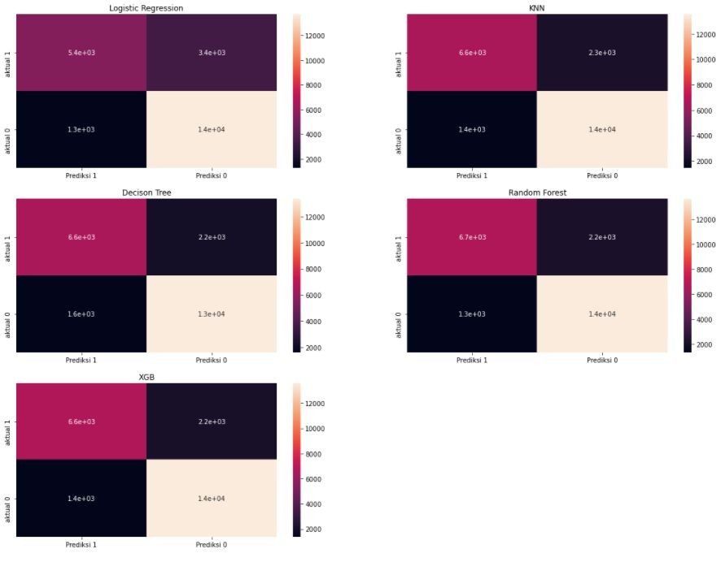

Slide 34



Slide 35

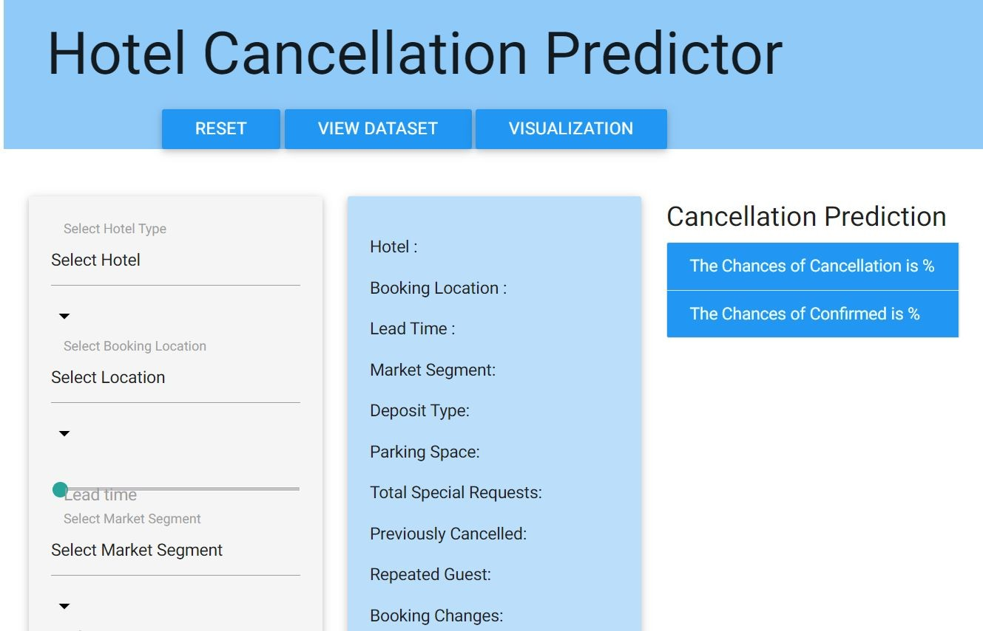
The Dashboard have drop down option and sliders to adjust the user input
The dashboard also have pages to see the dataset & visualization of the chart
This Dashboard uses predict_proba instead of predict to show the user probability of a canceled
/ conﬁrmed booking

Slide 36
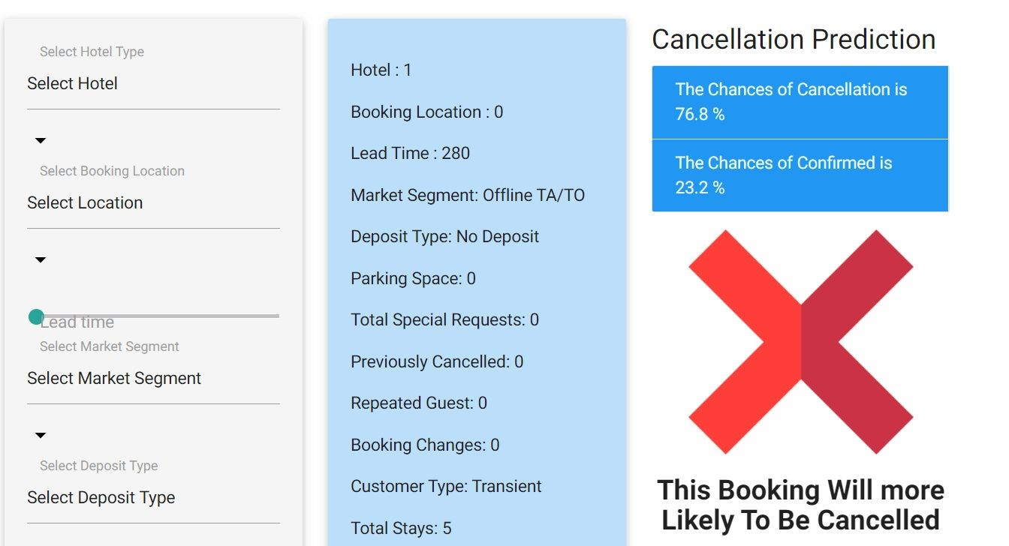
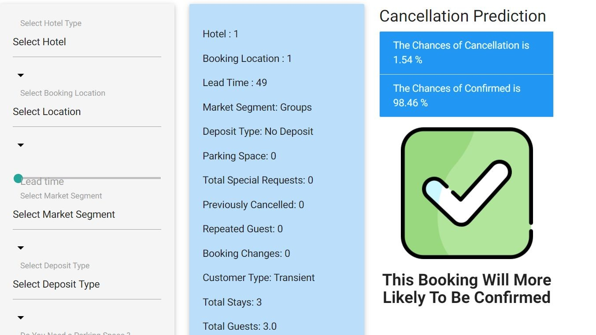

Slide 37


Connect with me :
priyank_dimri@hotmail.com

